Slide 1
Lesson 4 - Iterating Over an Array
Mr Mack 2019

Slide 2
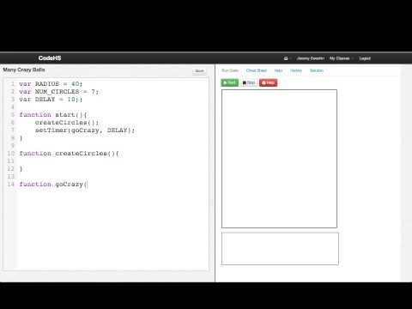
Iterating Over an Array

Slide 3
What kinds of items can we store in arrays?
numbers only
strings of text only
numbers or strings of text
any kind of object (anything you can store in a variable)

Slide 4
Example: Coin Flips
This is an example for this lesson. You are encouraged to play around with it, run and change the code, and learn how it works. When you are done, click continue to go to the next problem.

Slide 5
Example: Many Crazy Balls
This is an example for this lesson. You are encouraged to play around with it, run and change the code, and learn how it works. When you are done, click continue to go to the next problem.

Slide 6
Exercise 5.4.1: Coin Flip Fun: Number of Heads and Tails
Starting with our program that creates an array of coin flips, add a function that
prints out the total number of heads and total number of tails flipped.
Your function should take the array of flips as a parameter like this:
function countHeadsAndTails(flips) {
// your code here
}

Slide 7
Exercise 5.4.2: Coin Flip Fun: Longest Streak of Heads
Starting with our program that generates a list of coin flips, write a program to print out the longest streak of heads in the list.
For example, if the flips were
Heads
Tails
Tails
Heads
Heads
Heads
Tails
Heads
The longest streak of Heads is 3.
You shouldn’t modify the flipCoins() function at all. You should write another function that takes the list of flips as a parameter and counts the number of heads there.

